Slide 1
Welcome to Math in Nature Seminar.

Slide 2
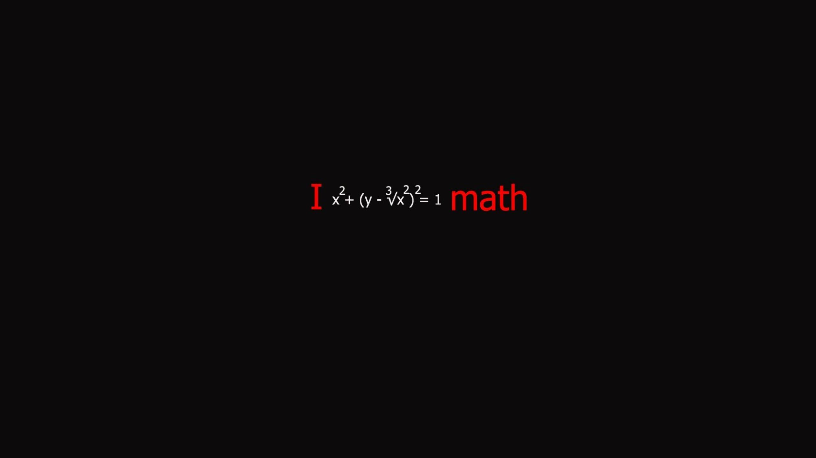
Contents:
Introduction
History
Fibonacci Series
Fractal Geometry
Golden Ratio
Conclusion

Slide 3
Introduction:
Mathematics, the science of structure, order, and relation that has evolved from elemental practices of counting, measuring, and describing the shapes of objects. It deals with logical reasoning and quantitative calculation, and its development has involved an increasing degree of idealization and abstraction of its subject matter. Since the 17th century, mathematics has been an indispensable adjunct to the physical sciences and technology, and in more recent times it has assumed a similar role in the quantitative aspects of the life sciences.
All mathematical systems (for example, Euclidean geometry) are combinations of sets of axioms and of theorems that can be logically deduced from the axioms developed and theorized since the early stages of human civilization. Inquiries into the logical and philosophical basis of mathematics reduce to questions of whether the axioms of a given system ensure its completeness and its consistency.

Slide 4
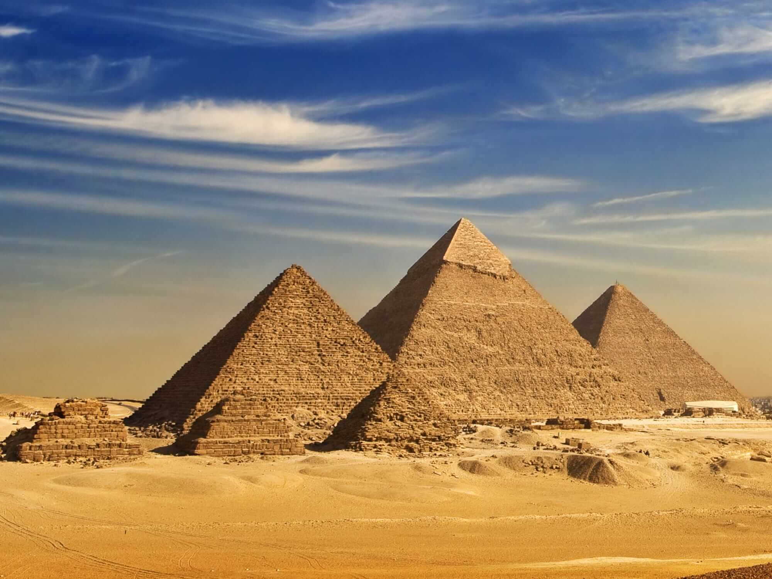
History of math:
Mathematics can be called the universal language, it has been developed in different forms across different civilizations throughout the human history but its core and basic concepts have mostly been same.
The word mathematics comes from the Ancient Greek term máthēma meaning “that which is learnt”. Mathematics has no generally accepted definition. Aristotle defined mathematics as "the science of quantity" and this definition prevailed until the 18th century. Math has helped humans understand the way nature and universe works around them.
In order to clarify the foundations of mathematics, the fields of mathematical logic and set theory were developed. Mathematical logic includes the study of logic and the applications of formal logic to other areas of science.

Slide 5
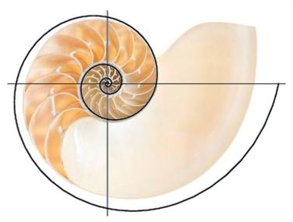


Fibonacci Series:
In Mathematics, the Fibonacci numbers, commonly denoted as Fn, form a sequence, called the Fibonacci Sequence, such that each number is the sum of two preceding ones, starting from 0 and 1. That is,
for n>1,
Hence the beginning of the sequence is,

Slide 6
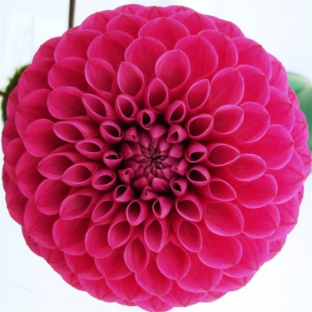
Fibonacci series in Nature:
Flower Petals:
The number of petals in a flower consistently follows the Fibonacci sequence. Famous examples include the lily, which has three petals, buttercups, which have five (pictured at left), the chicory's 21, the daisy's 34, and so on.

Slide 7
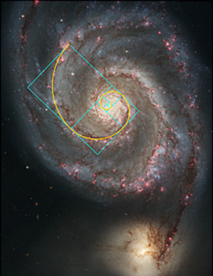
Spiral Galaxies:
Not surprisingly, spiral galaxies also follow the familiar Fibonacci pattern. The Milky Way has several spiral arms, each of them a logarithmic spiral of about 12 degrees. As an interesting aside, spiral galaxies appear to defy Newtonian physics. As early as 1925, astronomers realized that, since the angular speed of rotation of the galactic disk varies with distance from the center, the radial arms should become curved as galaxies rotate. Subsequently, after a few rotations, spiral arms should start to wind around a galaxy. But they don't — hence the so-called winding problem. The stars on the outside, it would seem, move at a velocity higher than expected — a unique trait of the cosmos that helps preserve its shape.

Slide 8
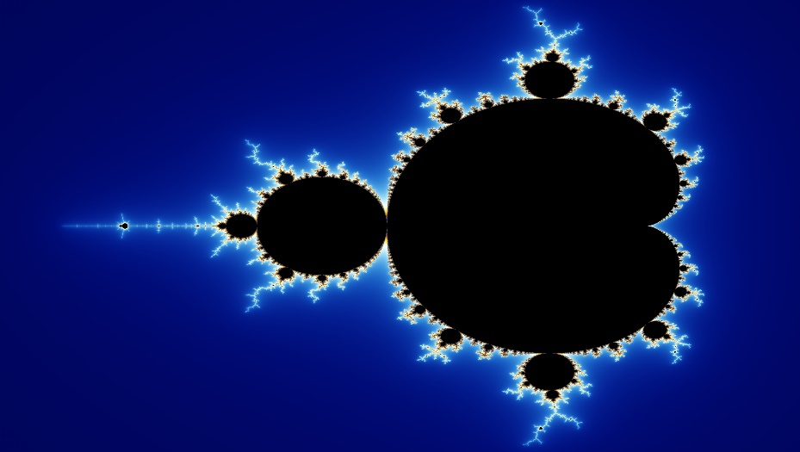
Fractal Geometry:
Fractal geometry is a field of maths born in the 1970’s and mainly developed by Benoit Mandelbrot.
Fractal geometry is no different from the classical geometry that we learnt in school, the difference being that the shapes that we drew were smooth like say a circle or a triangle while in fractal geometry the shapes are rough and infinitely complex.
Fractals can be seen everywhere around us. We can find fractals in our circulatory and respiratory systems, the trees that are around us (the branching of the trees and also the venation in the leaves), etc.

Slide 9
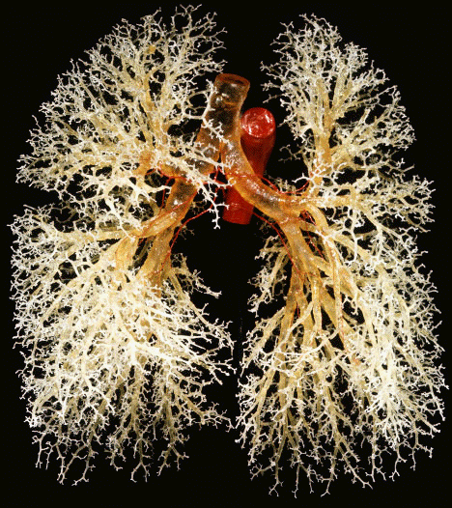
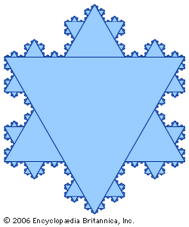
Fractals around us
Fractals in Animal Body
We can observe fractals in animal bodies. A very good example for this is the respiratory system. The respiratory system begins with a trachea and then goes on to branch into a network of fine-grained cavities.
The primary bronchi undergoes division to form secondary and tertiary bronchi which further divide to form primary, secondary and tertiary bronchioles.
Fractals in Snowflakes
The Koch snowflake is a fractal curve and one of the earliest fractals to be described.

Slide 10
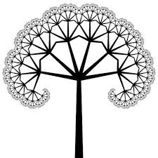
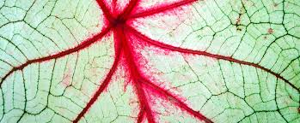
Fractals in Nature
Fractals are seen in the branches of trees from the way a tree grows limbs. The main trunk of the tree is the origin point for the Fractal and each set of branches that grow off of that main trunk subsequently have their own branches that continue to grow and have branches of their own.
Eventually the branches become small enough they become twigs, and these twigs will eventually grow into bigger branches and have twigs of their own. This cycle creates an “infinite” pattern of tree branches. Each branch of the tree resembles a smaller scale version of the whole shape.
In leaves: The midrib of the leaf becomes the starting point of the fractal. Further the veins of the leaves go on branching from one to other thus creating an infinite pattern.

Slide 11
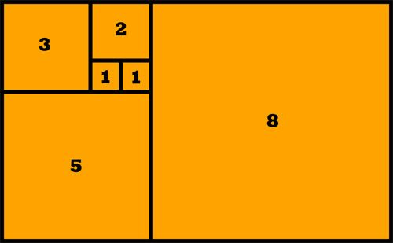
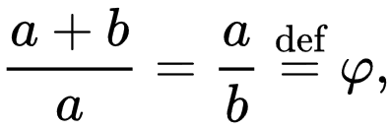
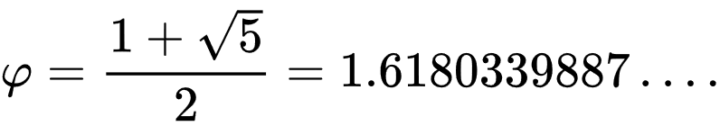
Golden Ratio:
The Golden Ratio was first described in Euclid’s Elements around 2,300 years ago.
The harmony and proportions of the Golden Ratio were recognized by mathematicians like Aristotle, Pythagoras, Musa Al Khawarizmi and Boethius.
Two quantities are in the golden ratio if their ratio is the same as the ratio of their sum to the larger of the two quantities. Expressed algebraically, for quantities a and b with a > b > 0,

Slide 12
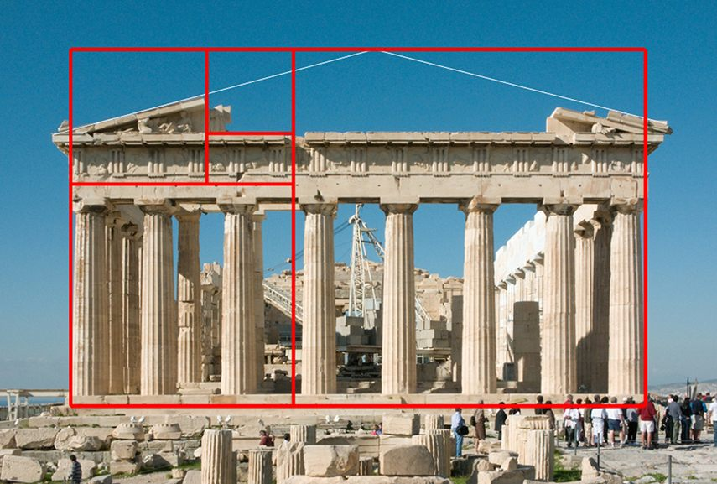
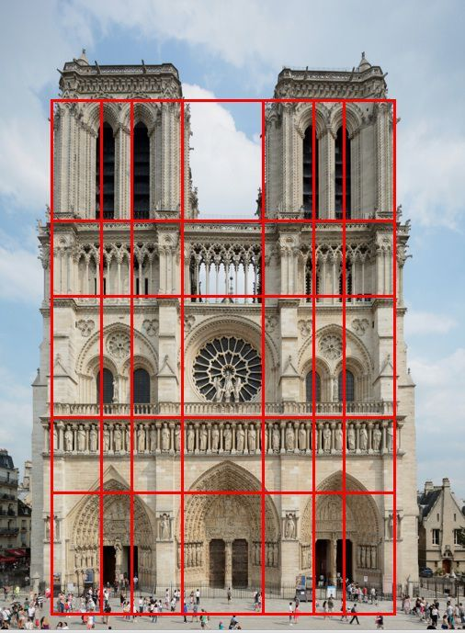
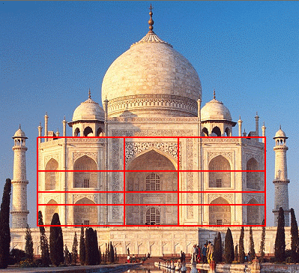
Golden Ratio in Architecture
The Parthenon (447–432 BC), was a temple of the Greek goddess Athena. The Parthenon's facade as well as elements of its facade and elsewhere are claimed to be circumscribed by a progression of golden rectangles.
Parthenon Notre Dame Taj Mahal

Slide 13
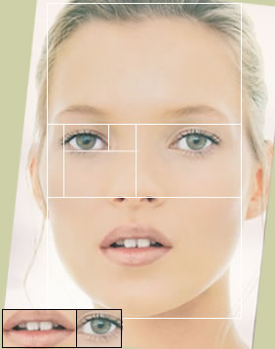
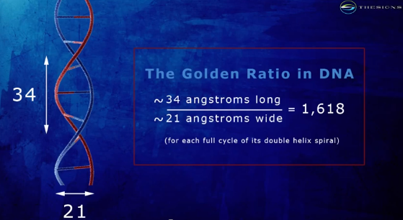
Golden Ratio In Biology
Human and Non Human Face
Faces, both human and nonhuman, abound with examples of the Golden Ratio. The mouth and nose are each positioned at golden sections of the distance between the eyes and the bottom of the chin. Similar proportions can been seen from the side, and even the eye and ear itself .
DNA Molecule
Even the microscopic realm is not immune to Fibonacci. The DNA molecule measures 34 angstroms long by 21 angstroms wide for each full cycle of its double helix spiral. These numbers, 34 and 21, are numbers in the Fibonacci series, and their ratio 1.6190476 closely approximates Phi, 1.6180339(golden ratio).

Slide 14
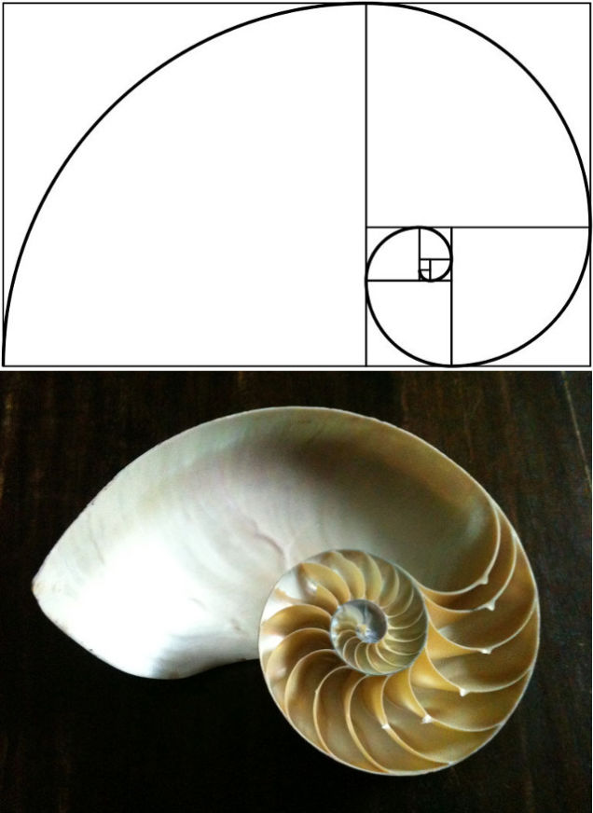
Golden Ratio in Shells:
The unique properties of the Golden Rectangle provides another example. This shape, a rectangle in which the ratio of the sides a/b is equal to the golden mean (phi), can result in a nesting process that can be repeated into infinity — and which takes on the form of a spiral. It's call the logarithmic spiral, and it abounds in nature.
Snail shells and nautilus shells follow the logarithmic spiral, as does the cochlea of the inner ear. It can also be seen in the horns of certain goats, and the shape of certain spider's webs.

Slide 15
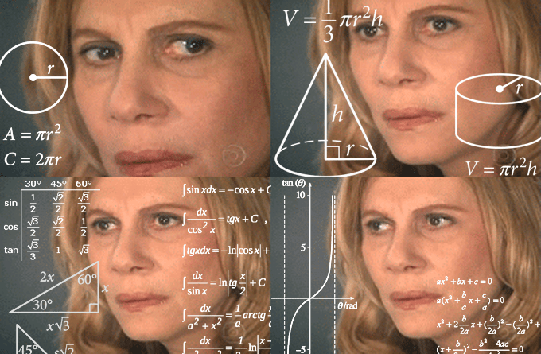
Conclusion:
It is not an overstatement to say that “Mathematics is the foundation of modern Human Civilization”. It is a language developed to fulfil the thirst and hunger of Human Civilization to better understand the Universe and its Working, and it has accomplished exactly that. It is undoubtably the greatest invention of Human Race. With Mathematics we have been able to solve some of the greatest mysteries of the Universe, the workings of nature and a find relation between all the living things and objects present in our observable universe.
References
https://www.bbvaopenmind.com/en/science/mathematics/when-magic-gave-way-to-numbers/
https://www.mic.com/articles/29778/pi-day-5-greatest-mathematical-discoveries-in-history
https://www.britannica.com/science/mathematics
https://www.mathnasium.com/examples-of-the-golden-ratio-in-nature

Slide 16
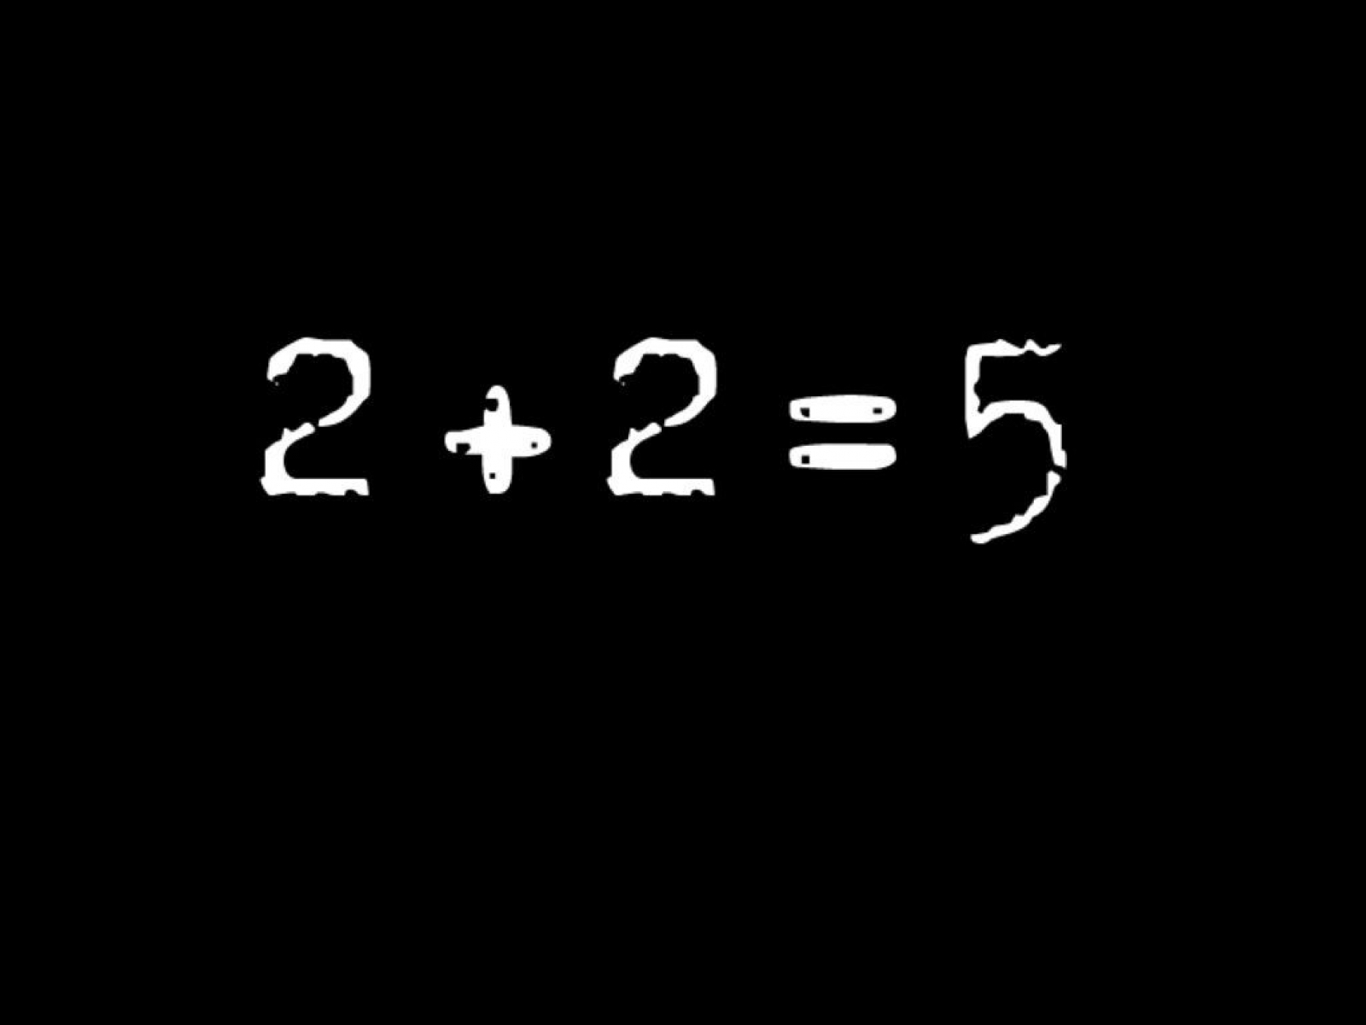
THANK YOU!!

